Slide 1
Study and implement van Emde Boas tree with application to Prims and compare wrt Union Find and RB Tree
Nabhiraj Jain (2019201062)
Vikram

Slide 2
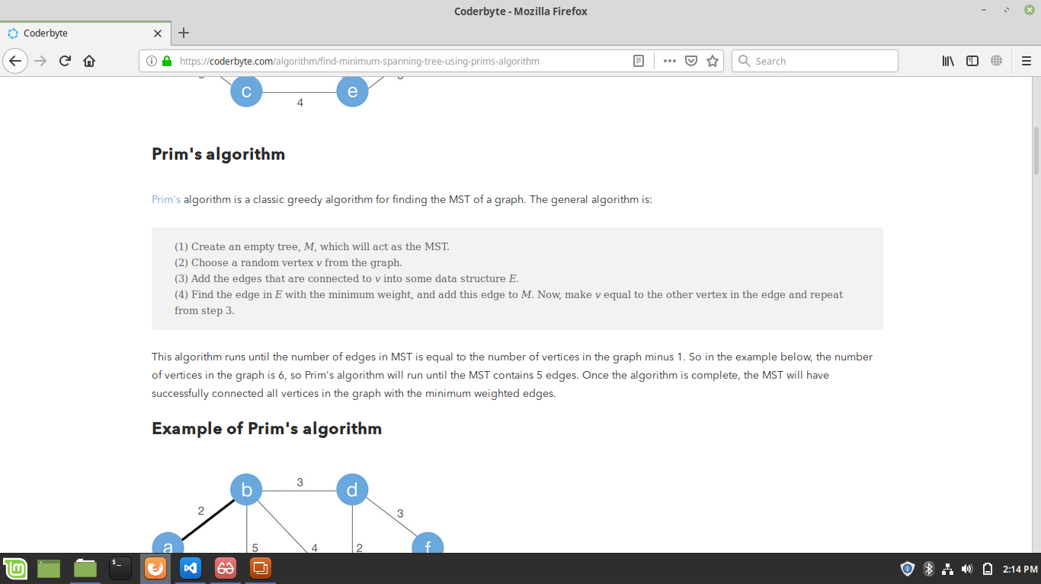
Task to be done..
Implementing a van Emde Boas tree.
Runing prims algorithm by using this Emde Boas tree.
Comapring van Emde Boas tree with Red black tree and union find in relation to prims algorithm.

Slide 3
How to compare...
Asymtotical complexity of prims algorithm.
Actual system time taken by all the tree configuration.
Cache hit/miss rate of diffrent algorithms.

Slide 4
Task done..
Understood the working of emde boas tree.
Understood the working of prims algorithm

Slide 5
Task to be done
Study of red back tree
Implimentation of emde boas tree
Implimentation of prims algorithm with our implemented emde boas tree.
Implimentation of prims algorithm with a union find.
Implimentation of prims algorithm with a red black tree.

Slide 6
Thank you

